Slide 1


VEHERE Interactive
ANOMALY
Device Fingerprinting
Proactive Cyber Defense
Internship 2020 BTech CSE CSF
RITAM GHOSH 160111046

Slide 2
Agenda Layout
01
Objective & Introduction
02
Methodology & Flow
03
Perspective & Functionality
04
Features, Scope & Conclusion

Slide 3

Objective & Introduction
Vehere Interactive Proactive Cyber Defense

Slide 4

OBJECTIVE
To develop a system which maintain monitoring, tracking and detection of anomaly signatures or sources. Also, to keep a record of all the incoming & outgoing packets. Basically, a fingerprinting device to counter security risks.

Slide 5
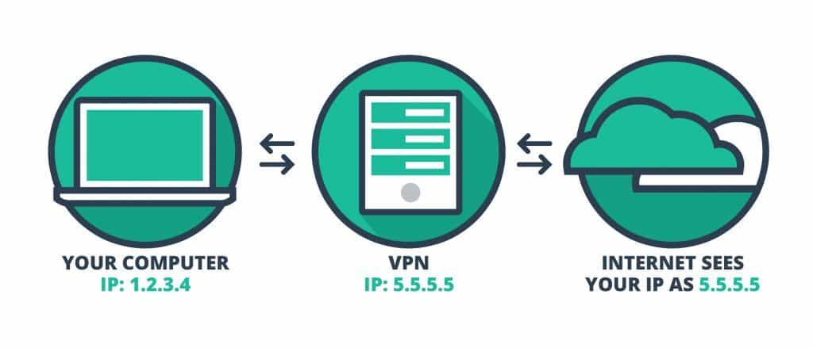
Introduction
Our system “Anomaly Device Fingerprinting” is a fingerprinting device used but in the specific context of anomaly, providing signatures & pattern analysis of incoming & outgoing processes of a network of an organisation to maintain security standards.
So, the topic “Anomaly Device Fingerprinting” is chosen to develop an automated system which can validates internal security from inside and outside world. It will not only act as a self-propelled firewall from an organisation but as a monitoring, tracking and detection system for an organisation having full control of it.

Slide 6


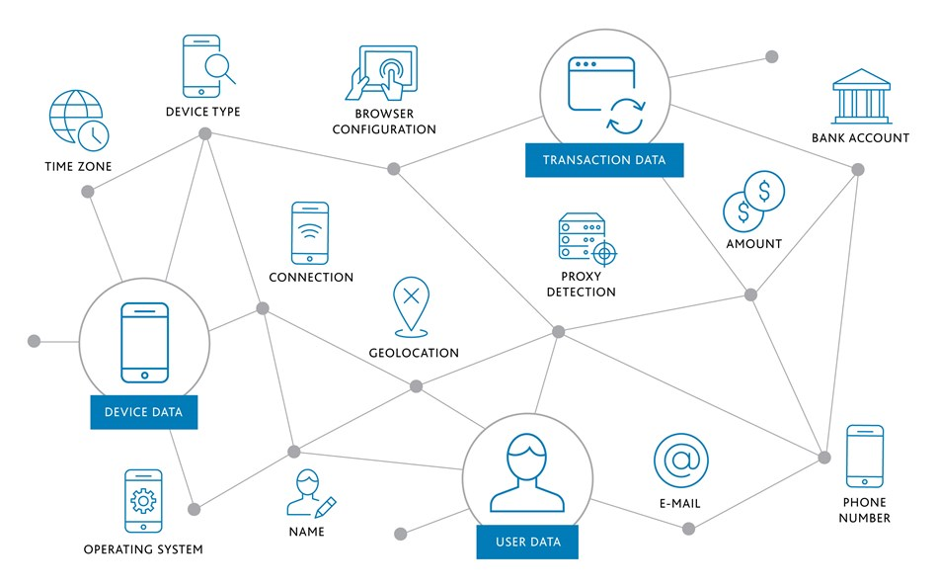
TYPES OF DEVICE FINGER PRINTING
Client-based methods
Server-based methods

Slide 7
COMBAT STRATEGY
Detecting anomalies related to the device fingerprint is a powerful way of providing real time fraud
detection.
ANOMALY DETECTION
Creating velocity filters based on a Device Fingerprint will enable you to minimize fraud costs even when names, credit card details and IP Addresses are changed.
DEVICE VELOCITY
TRANSACTION LINKING
A Device Fingerprint is a powerful tool for finding related transactions either as an identifier in itself or as a means of finding transactions with related characteristics
ACCOUNT LINKING
A Device Fingerprint is a valuable tool to be able to detect when accounts or subscriptions are being accessed or shared illegally.
DEVICE REPUTATION
If a device has been involved with fraud, adding that device to a blacklist will enable you to protect customers that share the same device reputation network.

Slide 8
Methodology & Flow
Vehere Interactive Proactive Cyber Defense

Slide 9
Methodology
MONITORING
INITIALIZING
ANALYSING
At this stage it compares new data to the excepted distribution of values generated. Monitoring is continuously performed on new data till it found any anomaly, then alert is generated
At the beginning, it is ready to collect the data passing over the network, with some initial values or parameters.
Here all the calibrated data are structed and filter as per requirement and data sets are created.
2
4 & 5
TRAINING & BUFFERING
CALIBRATING
1
3
6
In this stage the collected data are calibrated as no gaps are present, any broken or missing links.
In this stage models are designed and the data sets generated on bases of them and are evaluated. Here expected distribution of values are build and wait for enough data for being monitored.

Slide 10
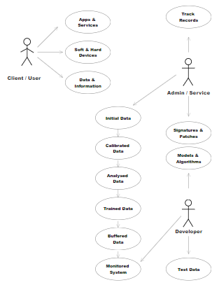
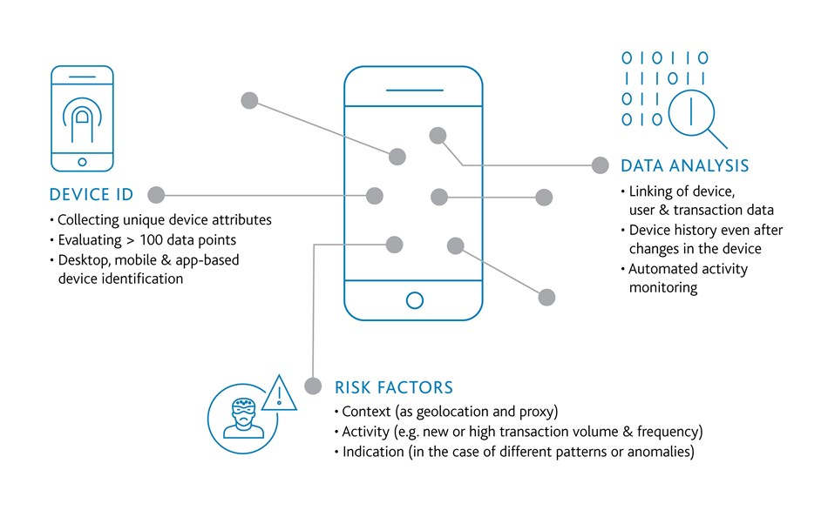
Activity Diagram
Activity Diagram shows the relationship between client / user with Admin / Service / Developer. Here the client / user is connected with apps, service, devices, data & info. Whereas admin / service & developer are connected with test data, models, algo, track records. This as a whole then passes through methodology stages

Slide 11
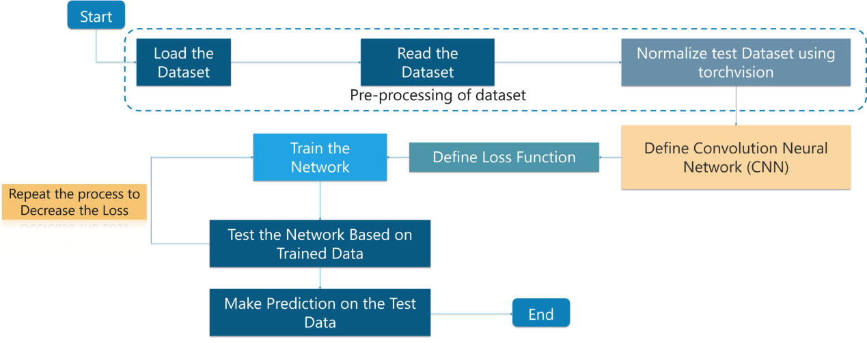
Flow Diagram
It denotes flow of data which takes places during testing & training using CNN & TensorFlow. Here the process begins with loading datasets where the datasets are then pre-processed & normalized then passes through CNN model where loss functions are defined then trained in a network. Then finally data are tested and prediction are processed.

Slide 12
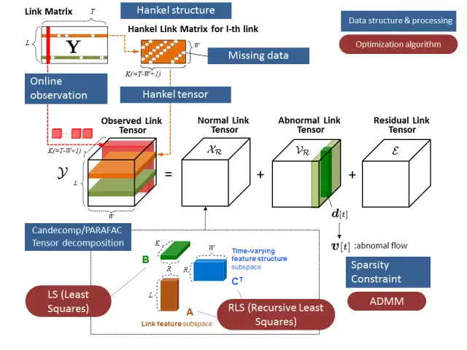
Anomaly Detection Architecture
It denotes flow of models used for anomaly detection, where cluster & classified training data are passes through tensor flow and Hankel tensor specifications, where the datasets are processed with
different stages to achieve desire outputs.

Slide 13
Perspective & Functionality
Vehere Interactive Proactive Cyber Defense

Slide 14
PROJECT FUNCTIONALITY
MONITORING
ANALYSIS
TRACKING & DETECTION
Our system monitors the network and analyses the real time data
captured and provides us with live
updates of the present scenario
During analysis phase data are
structured and filter as per
requirement needed for training, analysis and testing.
Our project can perform detection and
tracking on bases of anomaly patterns and signatures.
80%
60%
40%

Slide 15
PROJECT PARAMETERS
01
02
03
04
UNIQUENESS
PERSISTENCE
RESISTANCE
FIT
Uniqueness is the measure of how accurately and confidently you can identify a return computer and differentiate it from other computers on the internet. .
Persistence is the measure of how long you can expect to uniquely identify a device based on the fingerprint technique used.
Resistance is a measure of how well the Device Fingerprinting technique stands up to tampering by a hacker or fraudster.
Fit is the measure of how seamlessly the Device Fingerprinting technology integrates with your
business and technology requirements

Slide 16
Features, Scope & Conclusion
Vehere Interactive Proactive Cyber Defense

Slide 17
CONCLUSION
1
2
3
As this technique is closely tied to network technology, its evolution is hard to predict but its usage is currently shifting. What we once thought could replace cookies as the ultimate tracking technique is simply not true.
The absence of a physical client or users at the time of the transaction with a new era of technology-driven identity theft means that there is a need for a new alternative to online identity verification. Device Fingerprinting, while not a panacea, is a valuable Device Intelligence tool capable of monitoring, detecting and stopping fraud that currently flies under the radar of outdated and outmatched fraud detection
systems.
Finally, device fingerprinting will stay in the near future at a decade. This technique is so rooted in mechanisms that exist since the beginning of the web that it is very complex to get rid of it. It is one thing to remove differences between users as much as possible. It is a completely different one to remove device-specific information altogether.

Slide 18
SCOPE OF WORK
Its fascinating aspect is that it is at a crossroads between companies, academic research groups, law makers and privacy advocates. As it got out of the research lab, it has a concrete impact on the web as it is now used in real-world scenarios.
Devices fingerprinting represents an alternative to current methods of tracking and identification at a time where the ad landscape is undergoing tremendous changes with the rise of ad blockers.
All in all, device fingerprinting is still a fairly new technique. Yet, it already had a lot of impact in its short time of existence. Our effort to systematize existing knowledge proves there are still many open challenges and problems to be solved as researchers and developers are coming to grasp with its intricacies.
For law makers, device fingerprinting represents an additional tracking mechanism that must be regulated so that the control is given back in users’ hands. For journalists, activists, The military that rely on the confidentiality and privacy of their communications.

Slide 19

Thank you
RITAM GHOSH

